Slide 1
Adventures in Async: Part III Master Reactive systems on IBM Cloud TALK Grant Steinfeld - IBM Developer Advocate Java & Blockchain Grant.Steinfeld@ibm.com Twitter: @gsteinfeld GitHub presentation https://bit.ly/2GMrKVe

Slide 2
Lagom?
Notes:
Lightbend
Lagom is an open source framework for building microservices in Scala or Java. Built on Akka and Play, it serves as an abstraction layer so you don’t need to have in-depth knowledge of those core technologies to suceed in developing a reactive system of microservices.

Slide 3
”If I’d asked people what they wanted, they would have said faster horses”
Henry Ford
Notes:
Why we need this…
We can’t make the horse faster, we need cars
Todays apps ms response time
The need for speed
Computers fast – but old software paradigms don’t take advantage of it.

Slide 4
Shake up your comfort zone Monolith
Microservices => Microliths => Set of Monoliths
Reactive Microservices => Microsystem
Notes:
SQL DB - J2EE/ASP.NET
A monolith disguised as a set of microservices – is still a monolith
Monolith
What is that
Does not scale to meet the demands of todays users
Data at rest single source of truth
Microservices are hyped be careful as they may just be monoliths with SOA / REST interface
Flask e.g. rangal …

Slide 5
Digital transformation is not easy
Admitting good enough may not be good enough!
Getting out of comfort zone
Explore new paradigms
Reactive System
Streams and realtime data Pipelines
Microservices/Microsystems
Notes:
So how do we change to

Slide 6
Definition of a micro-service
Notes:
Theory START Micro – not size #lines but scope
Service – remote web service/ endpoint rpc

Slide 7
Scalable Microservices = = > 5 essential traits
Isolated ==> elastic
Autonomous ==> scale system and dev teams
Single Responsibility ==> do 1 thing well
State ==> owned exclusively
Addressable ( location transparency ) ==> elastic
Notes:
What we need is to create Microservices that scale
Base on the elements of reative archtectures.
ISOLATION – design from day 1
– slice up your architecture
– define teams
– ms are now
Deploy parts now instead of a monolith CI/CD
EASIER to scale, monitor and debug and test – something difficult to do if the services are all tangled up in the big bulky Monolith
Once isolated, ms can be independent/ autonomous
Can scale
make resilient
SINGLE RESPOSOBILITY
”THIS is the UNIX PHILOSOPY. WRITE PROGRAMS THAT DO ONE THING AND DO IT WELL. WRITE PROGRAMS THAT WORK TOGETHER”
Strong idea over decades works
SINGLE purpose
Small program well defined responsobiltiy that works well with other small programs- unix pipeline e.g. echo “foo” | awk | grep “foo” > foo.txt
Size of Microserives, what can be considered micro. How many lines code → wrong questions instead micro should refer to scope of responsibility – and the guiding principle
Is the unix SRP – let it do one thing and do it well
State elephant in the room - > can be statefull or stateless
Often state in db – contention
State owned by Microservice
Microserice owns it’s DATA

Slide 8
Microservices come in systems
“One Actor is no actor. Actors come in systems” Carl Hewitt
Notes:
Like humans MS are autonomous and need to COMMUNICATE to Collobarte with each other to solve problems
Whats difficult is not creating microserives themselves, but managing the space between them.
Design using Actor Computation Model – Akka Actors

Slide 9
Cost of Maintaining the Illusion of a single “now”
Contention
Coherency
Notes:
What’s the cost of maintiing the illusion of a single now?
Contention – waiting for shared resouorces to become available
Coherency – delay for data to become consistent
Eventually consisten is REALITY is
Consistency – ACID vs ACID 2.0
EVENTUALLY CONSISTENT is OK

Slide 10
Events-First Domain Driven Design
Focus on events == facts == the past
Bounded Contexts let those define the service boundary
Data is scoped local to microservice – an aggregate?
Data outside – Eventual Consistency
Notes:
How do you go about thinking of architecting Microservices
Big problem was we focused on the STRUCTURE too early
The nouns -> like db tables
Event Storming – design proc stakeholeder etc in a room – AGILE sticky notes notes
Better to think of the actions that triggered the events
Where do the events end up – are these in an aggregate?
Internal state – event log
Contain mutable state Publish Facts
External state pub/sub facts to another MS/Actor(s)
Write to DB out of normanl flow -> Eventually Consistent.
Immutalbe variable - > functional languages like scal erlang or ocaml vs say java c++ or c#
Rely on stable variable that don’t change while observing them

Slide 11
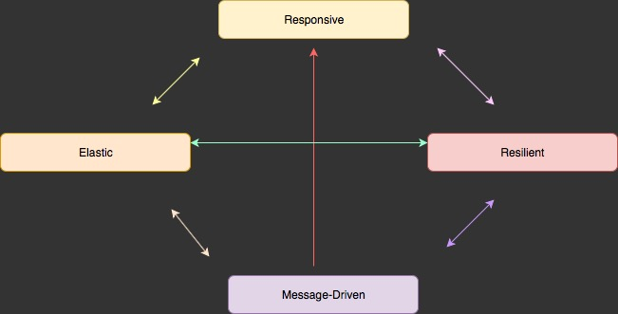
Reactive Manifesto is a pattern for building internet scale software These systems are more robust, more resilient, more flexible and better positioned to meet modern demands.
Notes:
Lightbend helped shape this

Slide 12
Reactive Microsystem Journey Embrace Reactive Programming Asynchronous Messaging ( avoid synchronous http ) fast data streaming pipelines Always apply backpressure Use circuit breakers
Notes:
Programming individual components code for async non blocking – streams with backpresseure -> Akka Streams Reactor Vert.x and RxJava
Systems infra for distributed systems focus on making them resilient and elastic – it is message driven based on asynchronous messaging – fast responsive ( non-blocking flow )
Async streams - Kafka
Data is now in streams and in motion v.s. Old days data at rest in large db.
Microservices need to embrace streaming as fundamental trait in order to stream data between services – fast data streaming pipelines
Backpressure flow control- backchannel consumer can manage flow by comm. With producer. Reactive Streams.
Circuit breakers
Off all in default – On triggered on – Half open. Allows increase resilience – self helaing prevents cascading effects.

Slide 13
Reactive Microsystem Journey Location transparency Self healing through bulkheading and Supervision Scale State and Behavior independently ==> finetune availability Aggregate Nodes – Akka Cluster
Notes:
Location transparency –
Address should always work – in practice message may end up in queue, logged, dead-letter
Virtual – allow for load balancing or relocation
Inversion of Control ( dynamic composition )
addressable – mobile – self healing – rehydration state
Self healing
Bulkheads – like in ship failure 1 compartment does not bring whole system down.’’
Supervisory trees
finetune availability
Separate Business Logic – Stateless – easy to do – load balancer - Servless from Stateful aggregate – system of record - system single source of truth
Harder to do high availibity DB
usually deployed active = passive clustering scheme for seamless failover.

Slide 14
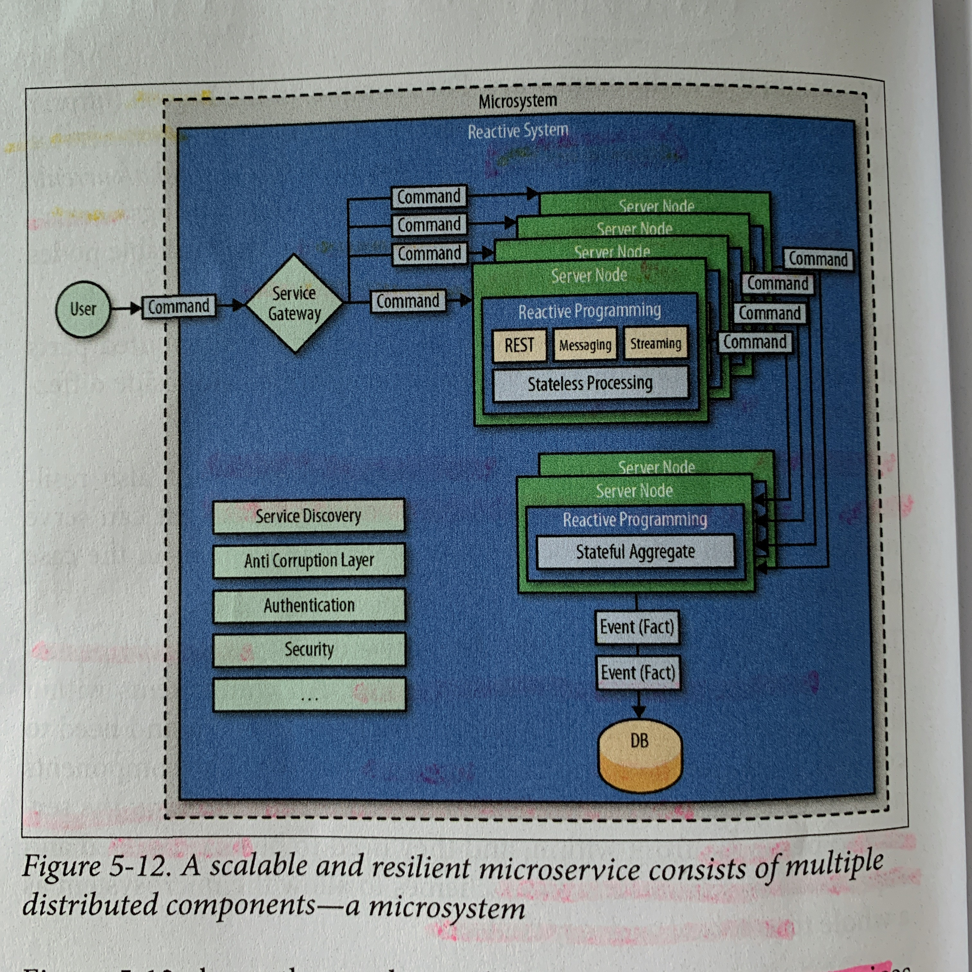
Microsystems
Notes:
A scalable and resilient microservice consists of multiple distributed components - a microsystem!

Slide 15
Scalable Persistence how to scale state while staying available? New ways of thinking about persistence and consistenxy. move beyond CRUD Create new facts by either adding more knowledge or drawing new conclusions from existing knowledge ( ML)
Notes:
How to scale state?
Create read OK
Accounting history .. Ledger append – no deletion records
Expensive disk – overwrite in past update in place – birthh of crud
Cheap disk now no reason not to use update in places store entire history of events
No need for Delete or update anymore!!
create new facts

Slide 16
Scalable Persistence “The truth is the log. The database is a cache of a subset of the log”. Pat Helland Event Logging Event Sourcing – aggregate to cache the dataset – latest snapshot in RAM Paired with Event stream ( Kafka ) -> downstream processing Command Query Responsibility Segregation CQRS – separate write and read models
Notes:
Pat Helland insightful paper “Immutability changes everything
1 of the most Scalabe ways to store facts is in an Event Log
Time natural index – allows for travel back and replay – debugging, auditing, repliocation and fail over – very powerful!
Popular pattern for event logging is event sourcing.
https://martinfowler.com/eaaDev/EventSourcing.html
EPIHPHANY !! Moved the Tranaction log && replaced RDBMS – to application level event source streams.
CQRS –addresses both query and consistency problems
By separating read from write = > temporal decoupling & Resiliance
TUNE ( read 100s noded ) – ( write 6 nodes ) flexible tuning of system resources $☺ At least once delivery!
Read – query- or anything that depends on data written by the write model Read a nd write svcs independanet of each other and don’t need to be available – allows eventual consistency ( better than no consistency guarantees at all)
at least once delivery!

Slide 17
Scalable Persistence Coordinating work across aggregates? Each event source aggregate should have an EventStream Publish Event – e.g. OrderCreated Other aggregates can subscribe and act in async decoupled way
Notes:
Finishes Theory

Slide 18
Which Microservice Framework?
Lagom
SQUBS
Custom Java or Scala deployment
Play
Akka
Actors | Cluster | Sharding | Persistence | Streams
Notes:
Many to choose
PayPal - > squbs (pronounced "skewbs") is a suite of components enabling standardization and operationalization of Akka and Akka HTTP applications/services in a large scale, managed, cloud environment.->
Lightbend - > Lagom
Netflix -> Hysterix
Hystrix is a latency and fault tolerance library designed to isolate points of access to remote systems, services and 3rd party libraries, stop cascading failure and enable resilience in complex distributed systems where failure is inevitable.

Slide 19

Building for concurrency, distribution and resilience
Akka is an open source, actor based, and message driven toolkit and runtime for the JVM
Actors
Akka provides a broad range of tools for building distributed applications to get the most out of your compute infrastructure.
Alpakka
Stream-based enterprise integrations
Alpakka Kafka
Stream-based integration for Kafka
Akka gRPC
Streaming gRPC servers and clients
Management
Extensions for operating Akka systems on clouds
Akka Streams
Asynchronous , non-blocking back-pressured stream processing
Actors: At the core of Akka, actors provide a model for concurrency and distribution without locks or need for thread management.
Cluster/Sharding
Distribution of actor systems
Persistence
State restoration for actors
Distributed Data
Conflict-free sharing data
Akka HTTP
Async, streaming HTTP server and client.

Slide 20

Building for speed
Play is an open source, asynchronous, non-blocking, stateless, streaming, reactive web application framework.
Full stack M-V-C web application framework
Play includes all you need to build web applications and REST services, such as
Integrated HTTP server (Akka HTTP)
Form handling
Cross-Site Request Forgery (CSRF) protection,
Powerful routing mechanism
I18n support, and more..
Uses Akka and Akka Streams under the covers to provide predictable and minimal resource consumption (CPU, memory, threads).

Slide 21

Building microservices quickly and correctly
Lagom is an open source framework for building reactive microservices
Lagom consistently applies proven design patterns to implement microservices for the JVM in Java or Scala
Thin, powerful abstraction layer
Principles
Single Responsibility
Encapsulation
Service Oriented
Hexagonal
Lagom handles the complexity of clustering, distributed persistence, sharding, intra-service communication
Patterns
Asynchronous & Non Blocking
Discovery
Eventual Consistency
CQRS
Domain Driven Design
Circuit Breaker
Service Location
Event Sourcing
Edge Service
Concurrency Toolkit / Runtime
Web Application Framework
Notes:
Services are asynchronous. Intra-service communication is managed for you.
Streaming is out of the box. Your microservices are resilient by nature.
Systems are distributed. Akka Cluster and Akka Persistence are under the hood.
Cluster sharding is implicit.
CQRS and event sourcing is made trivially easy. Your systems are cloud ready and elastic.
Lagom it serves as an abstraction layer so you don’t need to have in-depth knowledge of those core technologies to succeed in developing a reactive system of microservices.

Slide 22
Why Lagom? Why not just use Akka?
Lagom framework allows developers to focus on the business problem and the business logic
Decompose the application into services using Domain Driven Design and Event Storming
Create the services, persistent entities and aggregates
Create the interservice communications through well defined APIs
Lagom development environment simplifies development tasks
Builds and runs multiple services with a single command
Hot reloading upon source code changes
Start and manage custom services like Cassandra (for persistence), Kafka (for interservice messaging), service locator, and service gateway
Akka Persistence, Akka Cluster and Akka Sharding and Akka Actors are all used “under the covers” by higher level Lagom constructs
In a word: Productivity

Slide 23
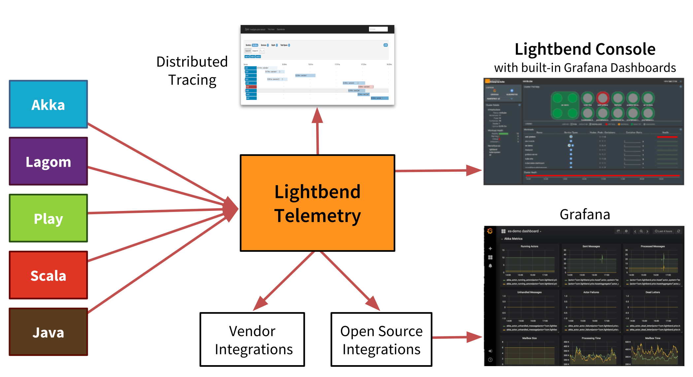
Lightbend Monitoring
Notes:
As you can see above Monitoring has two essential pieces; Telemetry (Cinnamon) and Lightbend Console. This documentation is focused solely on the former. Telemetry makes it possible to gather metric, event and trace information from Akka, Scala, Play, and Lagom based applications. The information is transferred to various backends. The rest of this documentation provides an overview of Telemetry and explains how to get started, configure and run Telemetry in production.
Lightbend Telemetry requires a subscription from Lightbend.

Slide 24
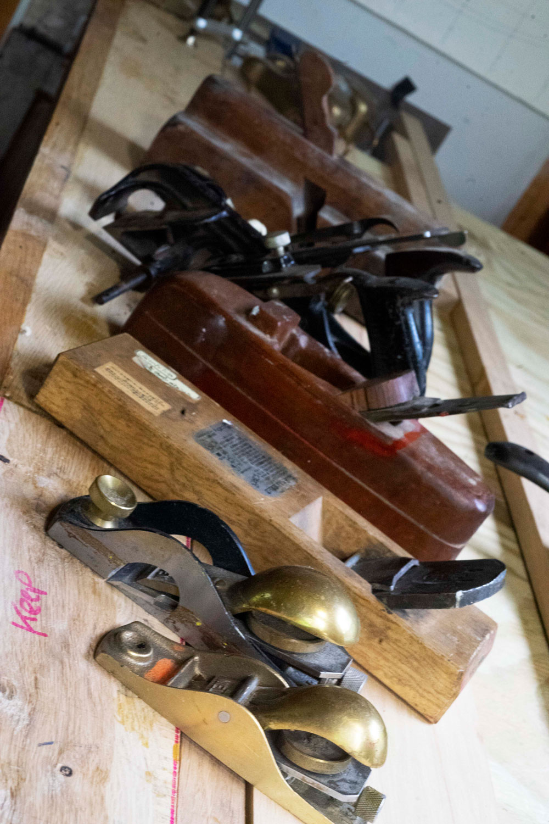
DEMO

Slide 25
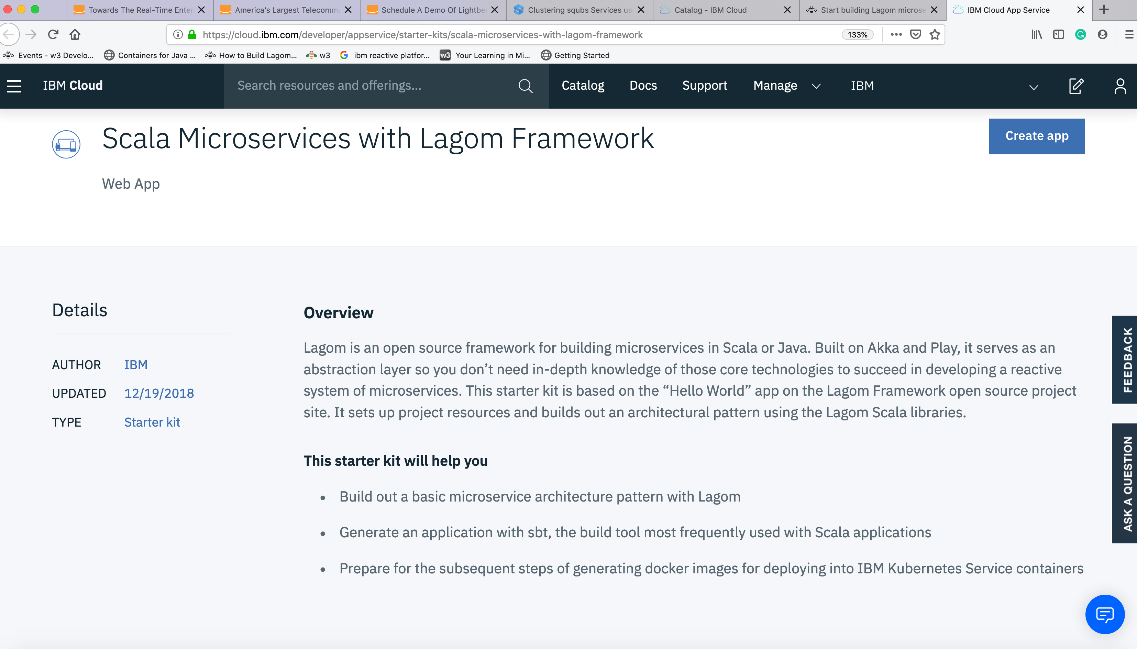

Notes:
Lagom Starter Kit for IBM Cloud - get’s Scala starter kit.

Slide 26
Simple example
Container (a)
Container (b)
Cart Service (a)
Intra-service messaging via Akka
Cart Service (b)
Entity 1 (a)
Entity 1 (b)
Entity 2(a)
Akka Cluster / Akka Sharding / Akka Persistence
Entity 2(b)
Container (c)
Kafka
Interservice messaging
of Domain Events
Kafka
Order Service
Entity 3
Entity4

Slide 27
Lagom – structure of a microservice – 3 elements
SERVICE CLIENT
Depednds on
SERVICE API
implements
SERVICE IMPL
Notes:
3 elements
API project – def interface for the microsvc
Impl project – implements the interface defined by the api
Client - uses service

Slide 28
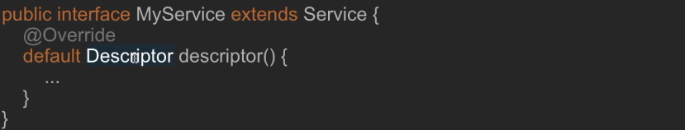
Lagom – Descriptors
Details svc defined using a descriptor
Descriptor is implemented as default method on the interface
Returns com.lightbend.javadsl.api.Descriptor

Slide 29
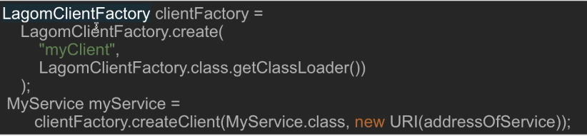
Lagom – Using external client
URL addressable

Slide 30
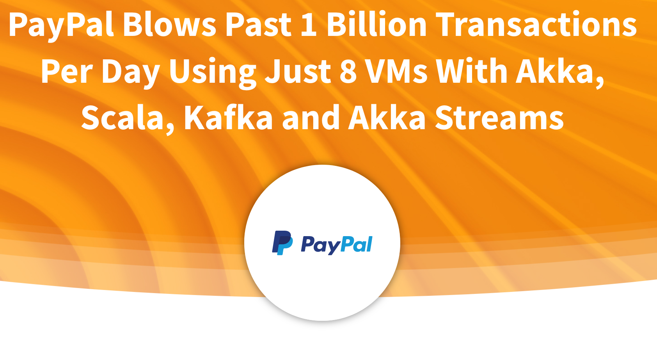
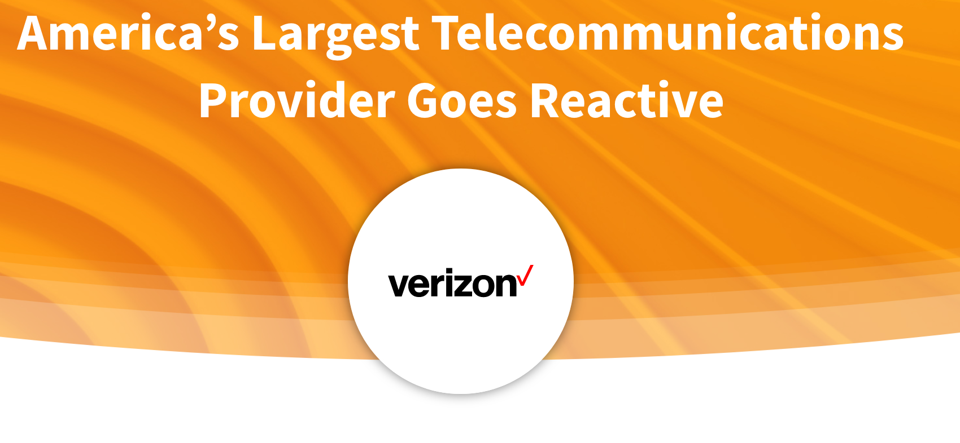
Use Cases
Notes:
Show excel as well!

Slide 31
Next steps Register for a free IBM Cloud account and start hacking Lagom Starter Kit https://ibm.biz/BdzMj9
Hands-On AIA - Part Ia – Reactive Functional Programming ( ~ End August )
Akka and actors model ( CodeCamp, VT September 28th
AIA Part IV – Apache Kafka and Reactive pipelines (~ October )

Slide 32
Resources and references
Start building Lagom microservices from IBM Cloud
The Log: What every software engineer should know about real-time data's unifying abstraction
https://martinfowler.com/eaaDev/EventSourcing.html

